Slide 1
Standard User – Collaboration: Request a Review
February, 2013

Slide 2

Learning Objectives
Upon completion of this course you will be able to:
Understand the ECM Review Process
Request a Review
Select Individuals to Perform a Review
Add Comments to a Review

Slide 3
Review Process
A review process is highly collaborative, and iterative requiring multiple “passes” through the different reviewers.
Traditionally, this is accomplished using emails, phone calls, and meetings.
  The ECM system speeds up the reviews and processing of comments and helps the author manage this process.
  However, if desired, much of the collaboration can be done “manually”, by checking out the contract, sending it via email to appropriate people, and eventually checking it back in.
After the author has requested a review from another user, the reviewer can:
  Review the task request
  Reassign the task to another User
  Decline the review task
  Review and edit the document as needed
  Include comments back to the Author and to other reviewers
  Indicate that they are finished reviewing the document.

Slide 4

Review Process, cont.
The system provides secure, single-user, on-line access to the document preventing simultaneous changes for different reviewers.
  Only one copy of a document can be open for editing at a time.
Requesting a review will not prevent the document from continuing through the contract lifecycle stages.
  The document can be presented to external third parties even if all review comments are not received.

Slide 5

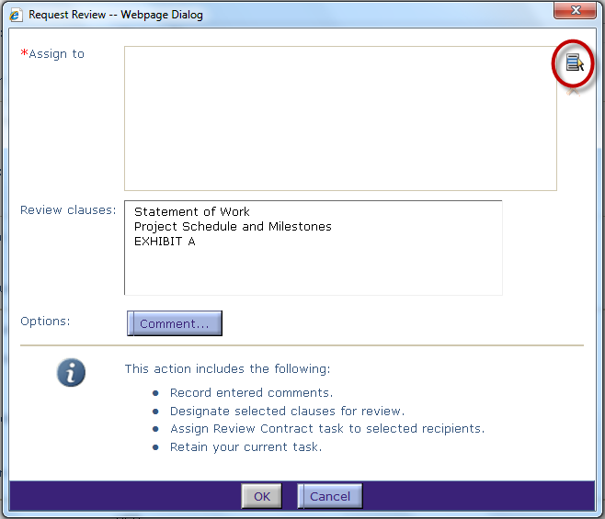
Request a Review
With the contract opened in the Contract Editor , click the Request Review icon on the main, blue toolbar.
The Request Review dialog box is displayed.
Here is where you identify the reviewers and the clauses you would like them to review.
In cases where different reviewers are to review different clauses, you’ll need to repeat the process for each unique group of reviewers and clauses.
To identify the reviewers, click the Select icon to the right of the Assign to field.

Slide 6
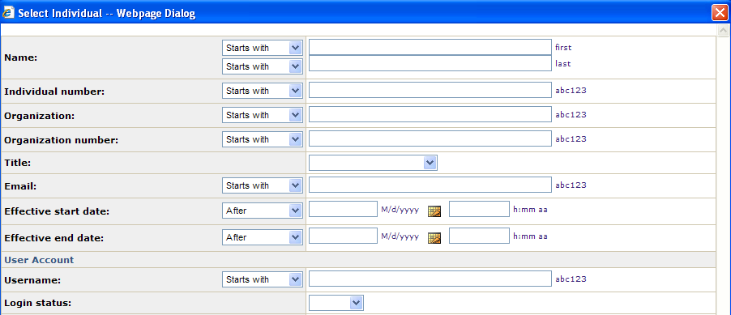
Select the Individual Reviewers
Enter a name or partial name in the First, Last, Username or Group name fields.
Or, you can leave all of the fields blank to see a list of all available reviewers.
Click Find.

Slide 7
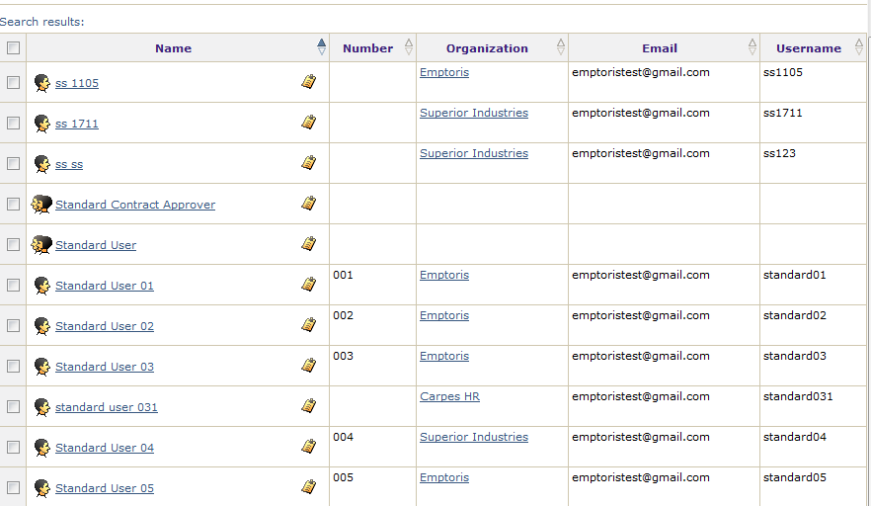
Select Individual Reviewers, cont.
Use the numbered menu and the chevron arrow buttons at the bottom of the list to navigate to the page that contains the name of the reviewer.
Click the check box, the hyperlink or just click in the row of the individual to highlight the name.
  Note: Click the small clipboard icon to view the properties (name, address, phone, etc.) of the individual.
Click OK when finished.

Slide 8
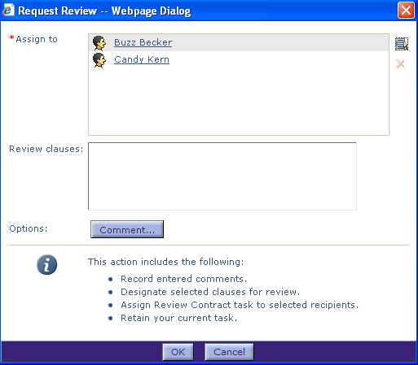

Select Individual Reviewers, cont.
Verify the list of Reviewers is displayed in the Assign to field.
The system auto-populates the clauses directly from the Contract. Click on each clause you would like reviewers to review.
  Hold down the Control key on the keyboard to select each individual clause in the list.
  NOTE: If no clauses are selected, the reviewer is requested to review the entire document.
Add a comment about the review.
  Click the Comment button.

Slide 9
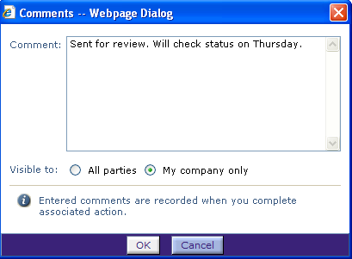
Add Comments
Enter your comment about the Review task.
  Comments should provide clear instructions to the person performing the review.
Click OK when done.
The Request Review dialog box is again displayed.
Click OK to submit the request to the list of reviewers.
The Contract Editor is re-displayed.
Remember to close your contract to allow reviewers to open it and make edits.

Slide 10
Review Request Process
The Reviewer receives an email notification and provides a link to the contract to request a review.
  The Reviewer’s My Task “Review” section will also indicate that a review is requested.
You can continue working on the contract until all reviews are complete.
However, when a reviewer opens the contract, the contract is then locked during their review.
  Only one reviewer at a time will be able to access the contract.
  You (the review requestor) can only view the contract in ‘read only’ mode while a review is being performed.
Once their review is complete, you will receive an email notification stating that the requested review is complete by that individual.

Slide 11

Questions?

